Slide 1
HYDRAULICS & HYDRAULIC MACHINES

Slide 2
Unit 2:
NONuniform flow in open channels

Slide 3
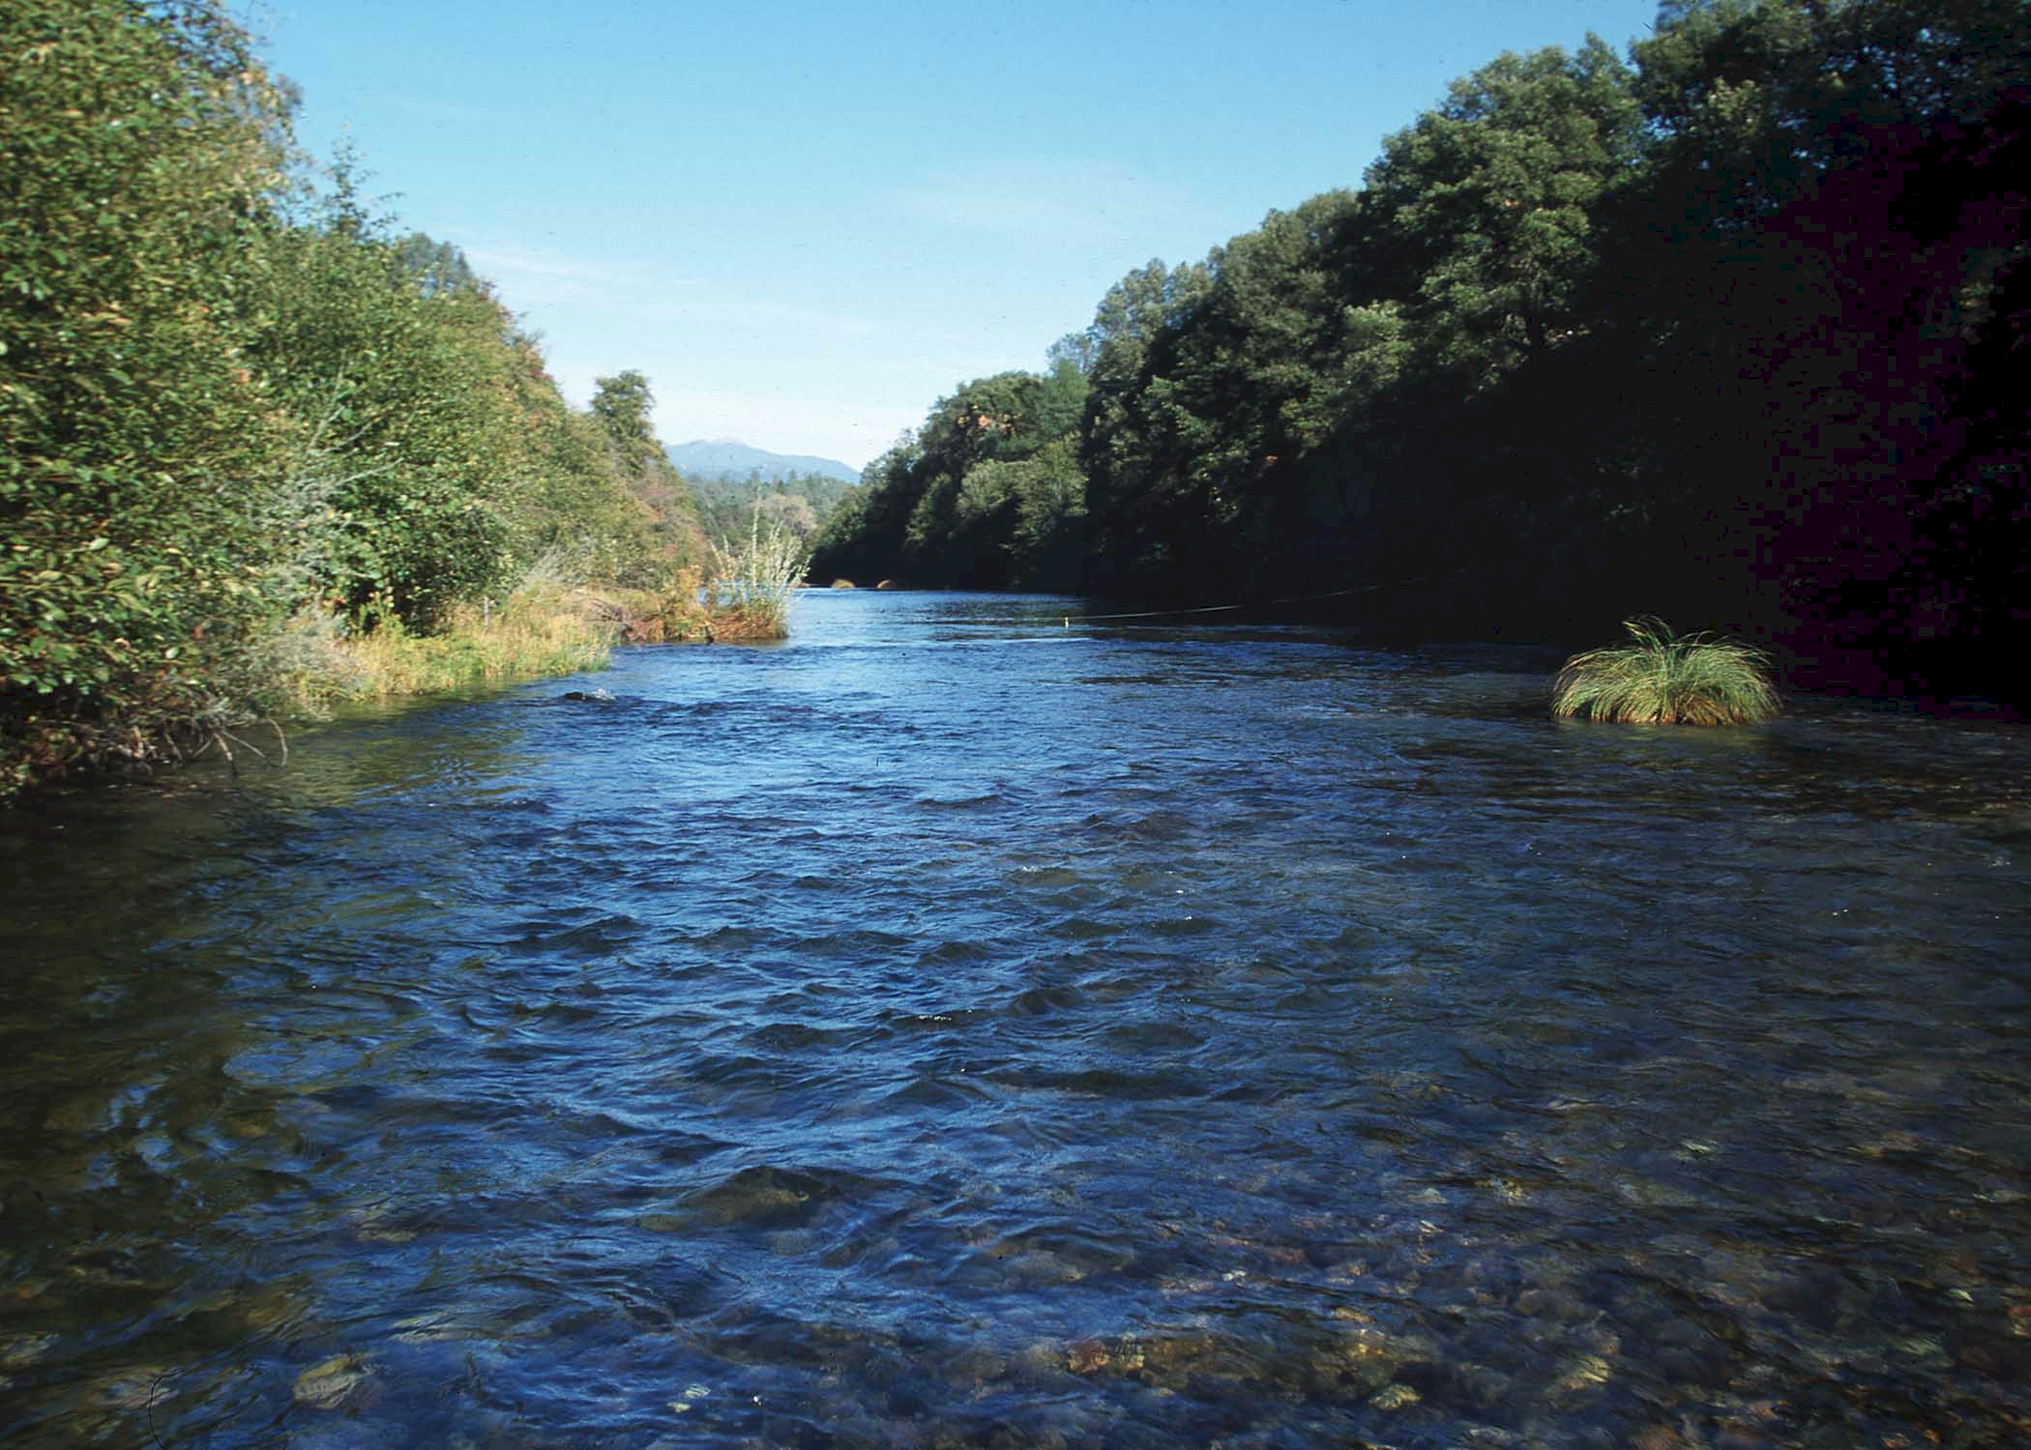

Slide 4
Learning Outcome
In this unit, you will learn
Concept of specific energy
Conditions for critical flow, subcritical flow and supercritical flow.
Conditions for maximum discharge
4. Hydraulic jump in rectangular channels
Conditions for maximum discharge
Dynamic equation for non-uniform flow in open channel
Classification of Surface profiles

Slide 5
Non uniform flow in open channel

Slide 6
Open Channel Flow: Energy Relations
velocity head
energy
______ grade line
hydraulic
_______ grade line
Bottom slope (S_{o}) not necessarily equal to EGL slope (S_{f})

Slide 7
Energy Relationships
Pipe flow
z - measured from horizontal datum
From diagram on previous slide...
Turbulent flow (α ≅ 1)
y - depth of flow
Energy Equation for Open Channel Flow

Slide 8
Specific Energy
The sum of the depth of flow and the velocity head is the specific energy:
y - _______ energy
potential
- _______ energy
kinetic
If channel bottom is horizontal and no head loss
y
For a change in bottom elevation

Slide 9
Specific Energy
In a channel with constant discharge, Q
where A=f(y)
Consider rectangular channel (A = By) and Q = qB
q is the discharge per unit width of channel
y
A
3 roots (one is negative)
B
2

Slide 10
Specific energy curve

Slide 11
Critical Depth
Depth at which specific energy is at a minimum
Other than critical depth, specific energy can occur at 2 different depths
  Subcritical (tranquil) flow d > d_{c}
  Supercritical (rapid) flow d < d_{c}

Slide 12
Critical Flow
y_{c}
Find critical depth, y_{c}
T
dy
A=f(y)
y
A
dA
P
T=surface width

Slide 13
Critical Flow : Rectangular channel
T
A_{c}
y_{c}

Slide 14
Critical Flow Relationships:Rectangular Channels
because
Froude number
inertial
force
gravity
force
velocity head =
0.5 (depth)

Slide 15
Critical Depth
Minimum energy for a given q
  Occurs when =___
  When kinetic = potential! ________
  Fr=1
  Fr>1 = ______critical
  Fr<1 = ______critical
0
Super
Sub

Slide 16
Critical Flow
Characteristics
  Unstable surface
  Series of standing waves
Occurrence
  Broad crested weir (and other weirs)
  Channel Controls (rapid changes in cross-section)
  Over falls
  Changes in channel slope from mild to steep
Used for flow measurements
  ___________________________________________
Difficult to measure depth
Unique relationship between depth and discharge

Slide 17
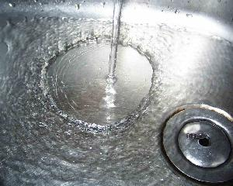
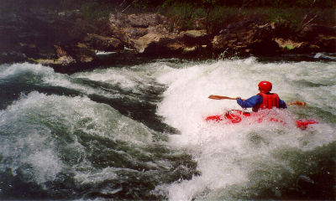
Hydraulic Jump
Used for energy dissipation
Occurs when flow transitions from supercritical to subcritical
  base of spillway
  Steep slope to mild slope
We would like to know depth of water downstream from jump as well as the location of the jump

Slide 18
Hydraulic Jump
Conservation of Momentum
h_{L}
EGL
y₂
y₁
L

Slide 19
Hydraulic Jump:Conjugate Depths
For a rectangular channel make the following substitutions
Froude number
valid for slopes < 0.02

Slide 20
Hydraulic Jump: Energy Loss and Length
Energy Loss
algebra
significant energy loss (to turbulence) in jump
Length of jump
No general theoretical solution
Experiments show
for

Slide 21
Hydraulic Jump Location
Suppose a sluice gate is located in a long channel with a mild slope. Where will the hydraulic jump be located?
Outline your solution scheme
reservoir
Sluice gate
2 m
10 cm
S = 0.005

Slide 22
Gradually Varied Flow: Find Change in Depth wrt x
Energy equation for non-uniform, steady flow
Shrink control volume
T
dy
y
A
P

Slide 23
Gradually Varied Flow: Derivative of KE wrt Depth
Change in KE
Change in PE
The water surface slope is a function of:
bottom slope, friction slope, Froude number

Slide 24
Gradually Varied Flow: Governing equation
Governing equation for gradually varied flow
Gives change of water depth with distance along channel
Note
  S_{o} and S_{f} are positive when sloping down in direction of flow
  y is measured from channel bottom
  dy/dx =0 means water depth is _constant______

Slide 25
Surface Profiles
Mild slope (y_{n}>y_{c})
  in a long channel subcritical flow will occur
Steep slope (y_{n}<y_{c})
  in a long channel supercritical flow will occur
Critical slope (y_{n}=y_{c})
  in a long channel unstable flow will occur
Horizontal slope (S_{o}=0)
  y_{n} undefined
Adverse slope (S_{o}<0)
  y_{n} undefined

Slide 26
Surface Profiles
Normal depth
Obstruction
Sluice gate
Steep slope (S₂)
Steep slope
Hydraulic Jump
S₀ - S_{f} 1 - Fr² dy/dx
+ + +
y_{n}
- + -
y_{c}
- - +

Slide 27
More Surface Profiles
S₀ - S_{f} 1 - Fr² dy/dx
1 + + +
2 + - -
y_{c}
y_{n}
3 - - +

Slide 28
Questions
Why isn’t Froude number important for describing the relationship between channel slope, discharge, and depth for uniform flow?
Under what conditions are the energy and hydraulic grade lines parallel in open channel flow?
Give two examples of how the specific energy could increase in the direction of flow.

